Slide 1
Multimodal learning for abnormality detection
Chihcheng Hsieh (Richard)

Slide 2
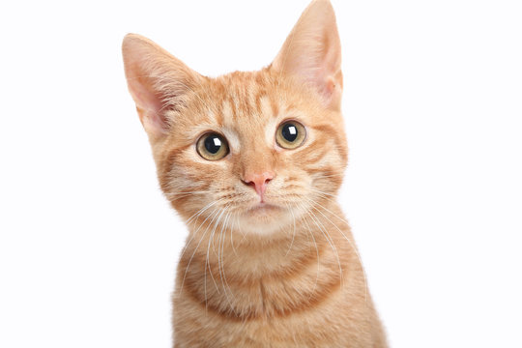
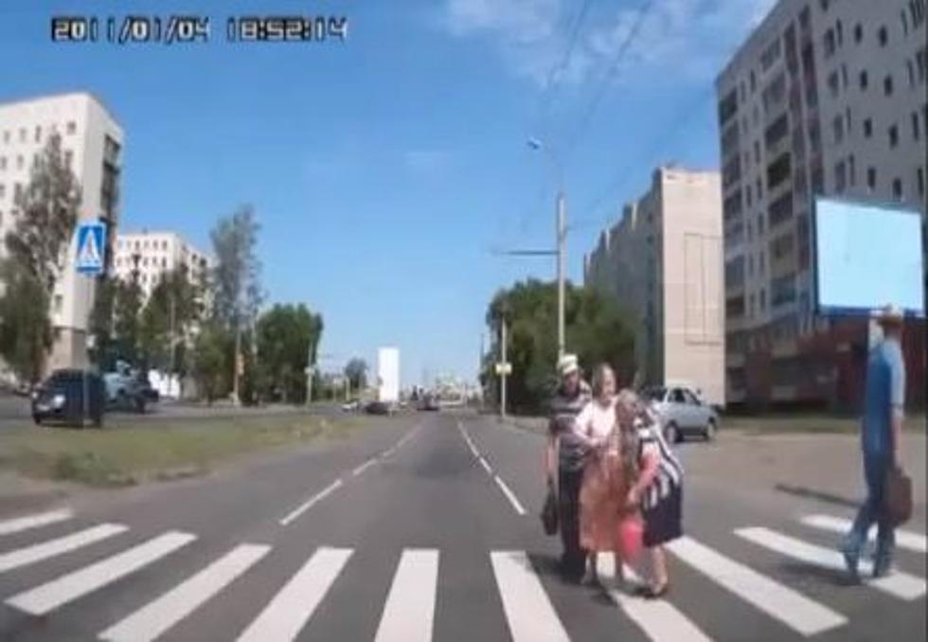
What’s an AI Model?
X
Y
Ａｎｉｍａｌ
Ｃｌａｓｓｉｆｉｅｒ
CAT
Ｓｅｌｆ－ｄｒｉｖｉｎｇ
Ｓｙｓｔｅｍ
ＢＲＡＫＥ

Slide 3
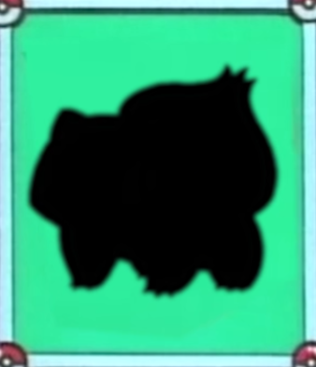
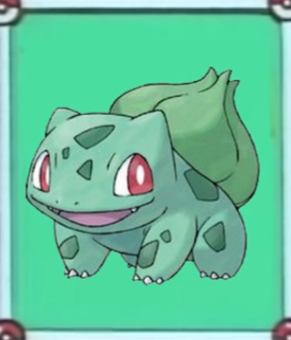
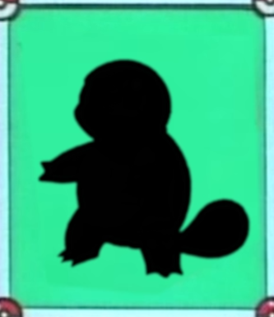
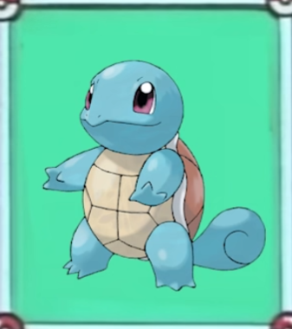
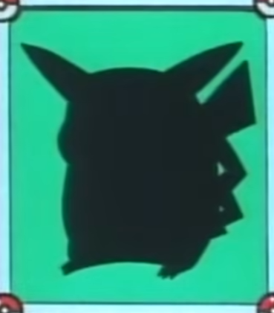
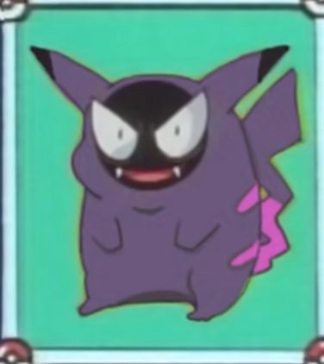
Ｐｏｋｅｍｏｎ ｃｌａｓｓｉｆｉｅｒ
Bulbasaur
Squirtle
Gastly

Slide 4
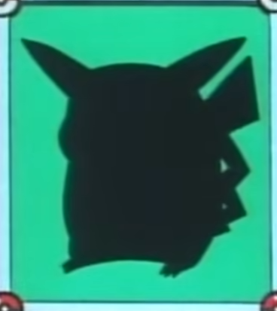

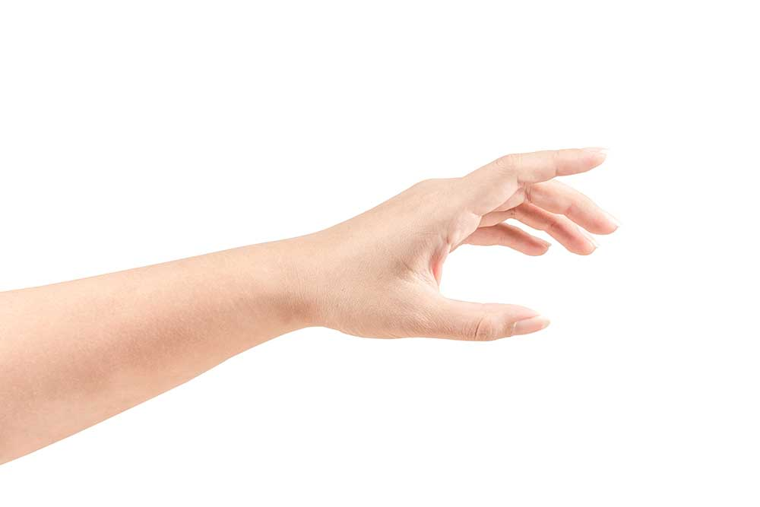
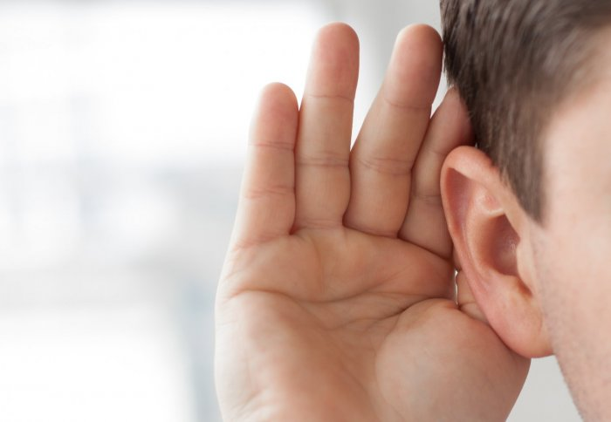
TO PREVENT that
Modalities

Slide 5
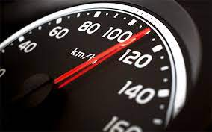
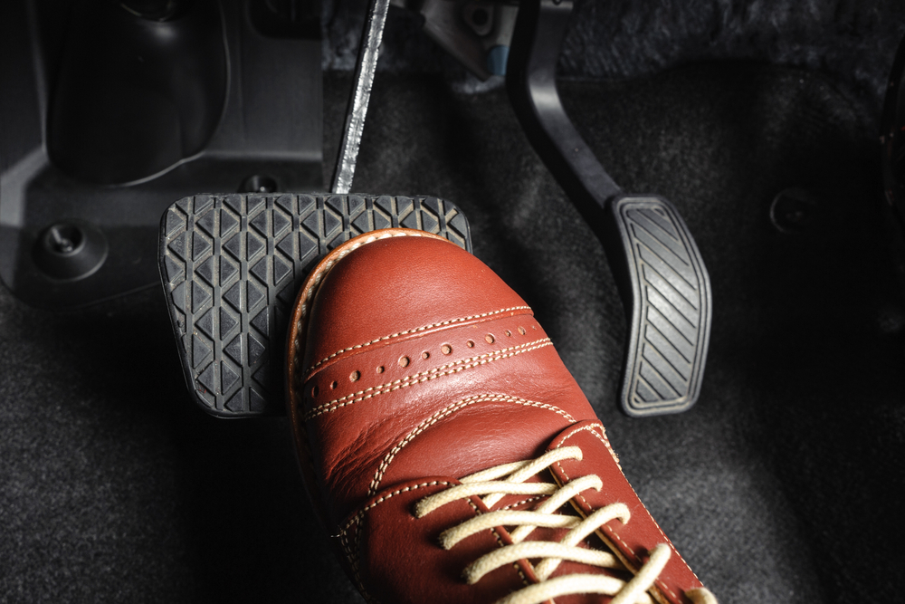
How Do we make discission

Slide 6
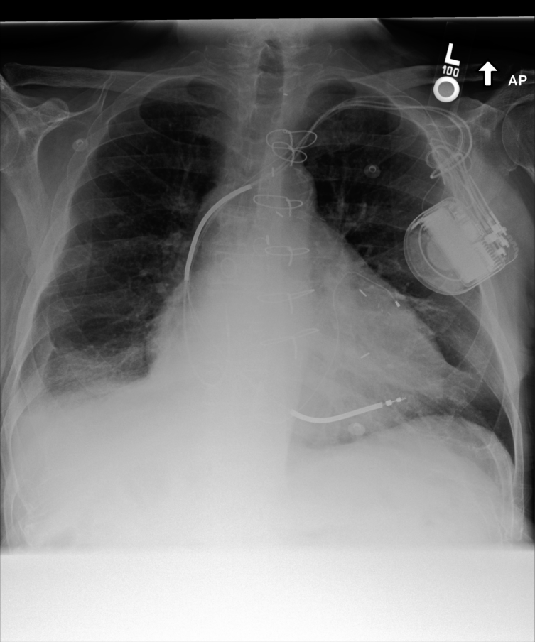
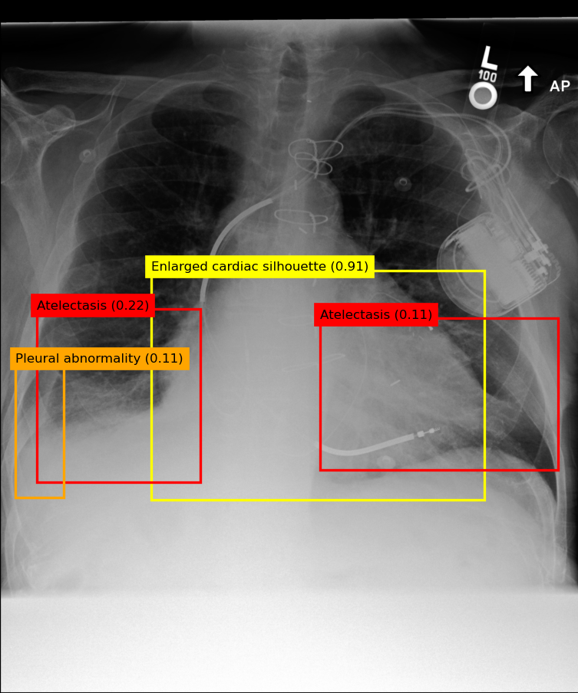
MEDICAL Image

Slide 7

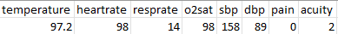
More modalities
Clinical Data

Slide 8
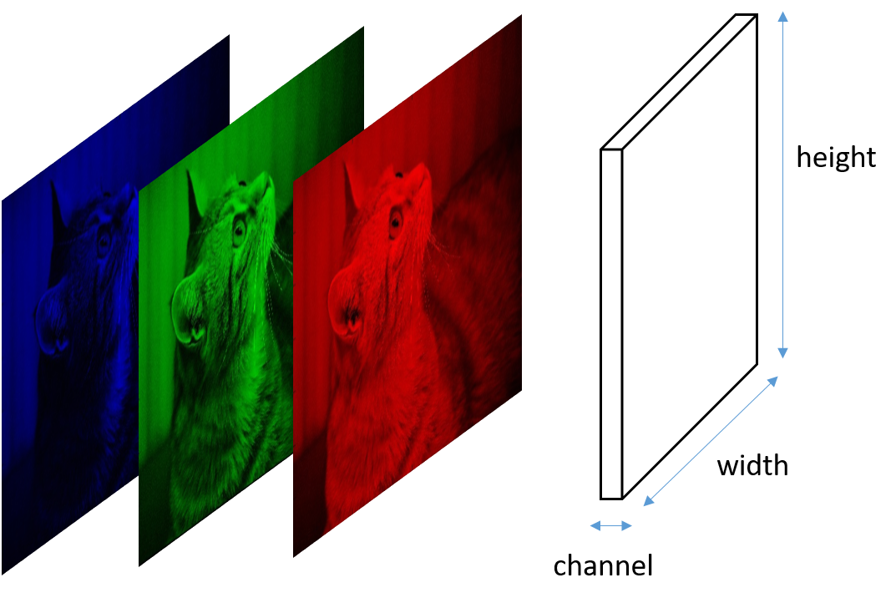
CHALLENGEs

Slide 9
END
Thank you

